Slide 1
SYSTEM PROGRAMMING PROJECT PRESENTATION
Presented by
Fawad Ali (19pwcse1845)
Umer Ali (19pwcse1824)
Wassam Rehman (19pwcse1829)

Slide 2
Implementation Of ls Command
.
Introduction
Problem statement
Proposed methodology
Flow chart
System calls
Conclusion

Slide 3
INTRODUCTION
In this project we implemented ls commands(with options)
The ls command is used to list files or directories in Linux and other Unix-based operating systems.
Synopsis: ls [flags] [directory]
Our program is using system calls with different options :
Ls –l
Ls –a
Ls –la
Ls –h
Ls –lh

Slide 4
Problem Statement
In order to list the files & directories to see what's inside our directory and which files & directories are present there .
In order to list all information about the file and directory.
In order to list all information about the file or directories that are hidden.
To see the memory used in kilobytes (size) etc.
To see the list files or directories in a table format with extra information including hidden files or directories.

Slide 5
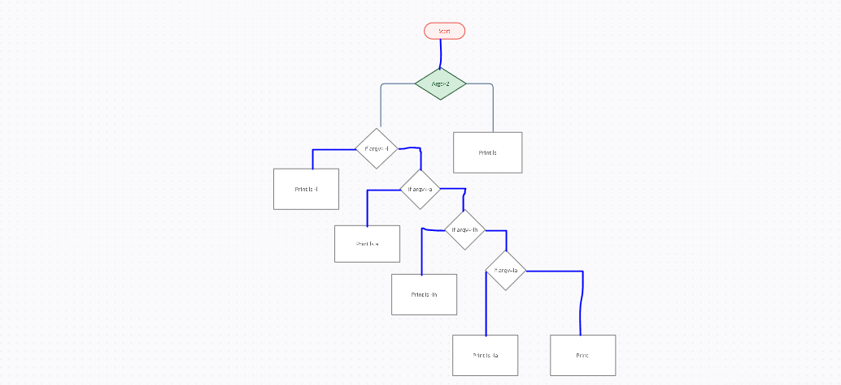
FLOW CHART

Slide 6
System Calls
Open(char * path, int options, int mode)
Opendir( )
readdir( )
fstat( )
lstat( )

Slide 7
System Calls
syscall( )
read-link( )
listdir( )
write( )

Slide 8
Conclusion
Ls command with options comes in very handy when listing or searching for the files or directories
Size of the directory and files.
Show us the hidden files
It shows all the information in one command.

Slide 9
THANK YOU

